Slide 1
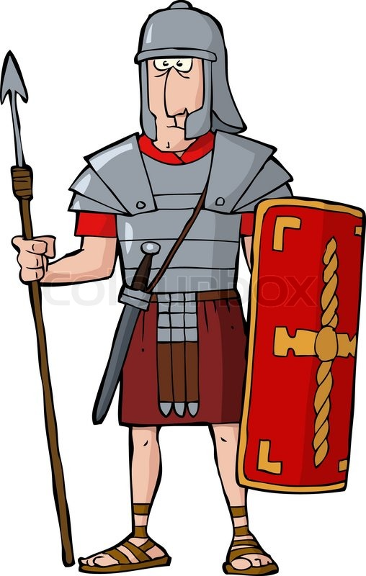
P.E
Our P.E days are Tuesday and Thursday. In the hall we will be creating and practising our own dance routines to 'Planets' by Gustav Holst. Outside we will be practising Hockey skills. The children will need indoor kit and warm outdoor kit and trainers.
Topic
Our topic this half term is The Romans! The children will be learning about the spread of the empire and army, homes, Pompeii, Celtic resistance, Boudicca and Roman myths and Gods.
Spanish and Music
The children will begin learning Spanish this term, starting with greetings. In music lessons we will be practising rhythm and also our listening skills.
Welcome to Year 3!
Maths
During Year 3 we will be focussing on our 3x, 4x, 8x tables. In this half term we will be working on place value in 3-digit numbers, start column method for addition and subtraction and begin multiplication and division.
Science
This term the children are learning about rocks and soils. They will investigate the properties of different rock and soil types and learn how fossils are formed.
Mrs Collins
and Mrs Ward
Snack
Every day children will need to bring in their own healthy snack (fruit, crackers, rice cake, cheese, plain biscuit) for the morning snack time and a bottle of water for during the day in the classroom. Please no nuts, crisps, chocolate or sweets.
Reading
Please read with your child 4x a week. This can be any kind of text. The children can change their school book each morning and can record any reading they do at home in their diary themselves, if an adult signs the parent signature in the diary. In school we will be reading together as a class using VIPERS skills to improve comprehension. We will check diaries once a week and reward with our marble scheme. Stickers and prizes. We will aim to read with your child once every 2 weeks.
Homework
We will test times tables and spellings each week on a Friday and give out new spellings. Rather than giving out regular homework, instead please help your child to practise their timetables and spellings at home as well as reading. I can recommend ways to help with this. Do ask.

