Slide 1
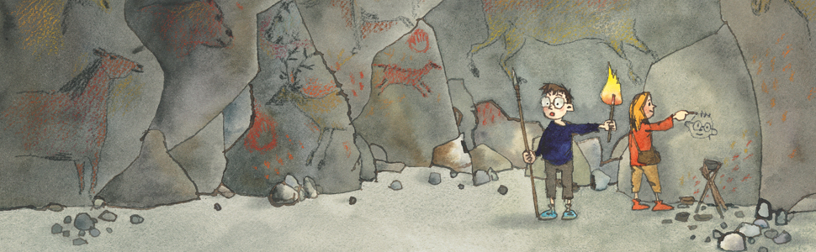
Maths
This term we will continue the 3, 4 and 8x table. We will also continue our Year 3 investigations into fractions including finding fractions of amounts. We will be using money by adding, subtracting and finding change. We will continue to regularly practise time telling skills on an analogue, digital and 24hr clock.
English
This term we will be reading stories and texts about the Stone Age. We will be writing an adventure story based on the story, Stone Age Boy by Satoshi Kitamura and an information text about the exciting discovery of Skara Brae in the Orkney Isles.
P.E
We will Football skills and Athletics, in preparation for the KS2 Sports Day. Please make sure that your child has a warm top and bottoms and trainers for P.E. It can still get chilly.
Year 3 Summer 1
Stone Age
Music
We will be having fun with ‘Disco’ music. We will listen and move to the hits of the disco era and learn to sing and accompany the song, ‘Bringing us together’ using our voices and the school glockenspiels.
Homework
We will continue to test times tables and spellings each week on a Friday and give out new spellings. Please help your child to practise their timetables and spellings at home as well as reading. 4x a week. It makes such a difference to their reading confidence.
Science
In science we will be looking at plants and using our skills of working like scientists we will investigate the functions of different parts of flowering plants and
explore the requirements of plants for life and growth (and how they vary from plant to plant.
We will also investigate the way in which water is transported within plants.
D.T & Art
We will be looking at cave art and creating our own pieces using chalk and crayon both on paper and on the floor. We will be researching and creating own Neolithic homes and experimenting in how to strengthen these homes.
PSHE & R.E
In Religious Education we will be looking at the question - What difference does being a Muslim make to daily life? For PSHE we will discuss how their actions affect themselves and others and look at their responsibilities in the world

