Slide 1
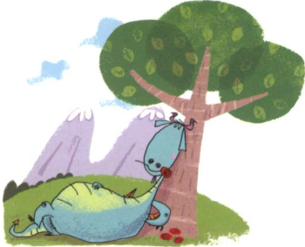
Maths
This term we will continue the 3, 4 and 8x table. We will also start our Year 3 investigations into fractions including understanding unit fractions and non-unit fractions, numerators and denominators .We will continue to regularly practise time telling skills on an analogue, digital and 24hr clock.
English
We will begin by writing a diary entry recount following our ‘Top Secret’ work as ‘Dragon Explorers’ searching for evidence of dragons. We will read a range of Dragon texts including ‘Tell me a Dragon’ and the ‘Reluctant Dragon. We will also look at the early chapters of ‘How to Train Your Dragon’. We will look use these to help us write a description of a type of dragon. Towards of the end of term we will then read different versions of a traditional tale ‘George and the Dragon’ and compare different versions of this famous story.
P.E
We will continue gymnastics looking at different balances, jumps and rolls using apparatus. Outside we will continue to play invasion and netball style games learning the skills necessary to play netball. This will be weather dependant. Please make sure that your child has a warm top and bottoms and trainers for P.E.
Year 3 Spring 2
Dragons…
Homework
We will continue to test times tables and spellings each week on a Friday and give out new spellings. Please help your child to practise their timetables and spellings at home as well as reading. 4x a week. It makes such a difference to their reading confidence.
Music
We will be learning ‘The Dragon Song’ in Music and will be looking at other traditional tunes and Folk
melodies from around the world. We will be performing using our voices and our glockenspiels.
PSHE & R.E
In Religious Education we will be looking at the question - What do Muslims believe about God?. For PSHE we will discuss feelings and how to communicate and describe these.
Science
We will learn about push and pull forces, investigate friction and magnets. We will investigate how different things move on different surfaces, we will look at how magnets work and label one, we will identify magnetic materials and investigate the strength of different types of magnets and how they work.
D.T & Art
We will begin by sketching different dragon eyes in detail and adding colour using watercolours. We will design and create our own eye using clay, sculpting materials and skills. Finally, we will paint and sealing our finished masterpiece.

