Slide 1
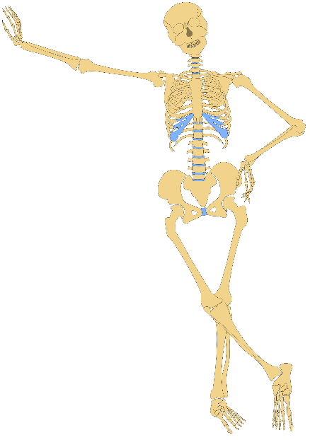

P.E
Our P.E days are Tuesday and Thursday. In the hall we will be perfecting our gymnastics skills. Outside we will be looking at the skills needed to be great netballers. The children will need indoor kit and warm outdoor kit and trainers.
Topic
Our topic this half term is Animals including Us! The children will be about the humans skeletons, other types of skeletons and how to keep our bodies healthy.
Spanish and Music
The children will begin learning Spanish this term, starting with greetings. In music lessons we will be focussing on Reggae music and performing Three Little Birds
Spring Term 1 in Year 3
Maths
This half term we will be focussing on written forms of multiplication and division using our fantastic 2,5,10, 3,4 and 8 times tables. We will also look at area and perimeter and start to look at fractions.
Science,English,DT and Art
This term our topic will lead much of our learning in these areas. We will be writing about our skeletons, writing instructions for a healthy meal and create a healthy pizza. We will be looking at the figurative sculpture of Giacometti and create our own versions.
Animals including Us!
Homework
We will continue to test times tables and spellings each week on a Friday and give out new spellings. Rather than setting regular homework, instead please help your child to practise their timetables and spellings at home as well as reading. I can recommend ways to help with this - do ask .
Snack
Every day children will need to bring in their own healthy snack (fruit, crackers, rice cake, cheese, plain biscuit) for the morning snack time and a bottle of water for during the day in the classroom. Please no nuts, crisps, chocolate or sweets.
Reading
Please continue to read with your child 4x a week. This can be any kind of text. We are really focussing on the children's understanding of what they are reading this half term. The children can still record any reading they do at home in their diary themselves, but an adult must sign the diary once a week. We continue reading together as a class using VIPERS skills to improve comprehension. We check diaries once a week and reward with our marble scheme, stickers and badges .

