Slide 1
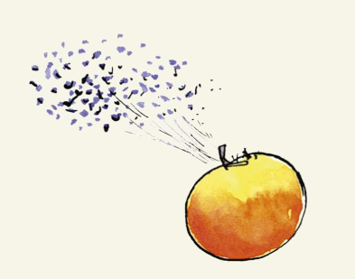
Maths
This term we will continue to be focusing on Addition and Subtraction. We will then move in to
Multiplication and division. We will be adding to numbers across the 10 and 100, and also subtracting two numbers across the 10 and 100. We will then begin looking at Multiplication and Division by looking at the Year 3 times tables in depth and how they are used in division as well as multiplication. The Year 3 Times tables as the 3s, 4s and 8s in addition to the 2s, 5s and 10s from Key Stage 1.
English
This term we will be reading stories by Roald Dahl, focussing on The Enormous Crocodile, The Twits, James and the Giant Peach and Revolting Rhymes. We will be writing a newspaper report and a short play script based on the Muggle Wumps and the Roly-Poly Bird.
Art
We will be focussing on art work by Quentin Blake and Georgia O’Keefe. We will create paintings of poppies and a Roald Dahl character using watercolour techniques.
P.E
For outdoor P.E will be lookinh at Tag Rugby skills indoors we will be trying out some relaxation and balance techniques.
Music
This term we will be focusing on learning our Year 3 Christmas song and also our whole school songs for the School Christmas Carol concert. We will be talking about performance skills, following a conductor and working together.
Geography
This term we will be recapping the continents and oceans of the Earth. We will also be looking at maps including using the 8 points of the compass, using Four-Figure grid references, symbols & keys and finally we will design a map of the North Pole – just in time for Father Christmas!
Year 3
Roald Dahl
PSHE & R.E
In Religious Education the children will investigate how people express a
commitment to a religion or worldview in different ways focusing on Christianity, Judaism and Sikhism.
In PSHE we will be talking about anti-bullying and what we can do about it in our classroom. We will have some circle time sessions to discuss feelings, thoughts and any issues as they arise.
Science
Our science topic this half term is Light. The children will be investigating what light is, how shadows are formed and how light travels. They will be recognising that they need light in order to see things and that dark is the absence of light.
They will also notice that light is reflected from surfaces.
D.T
In design and technology we will be designing and creating a small Christmas decoration using sewing skills including blanket stitch.

